Slide 1

Why Data Engineering?
Presenter: Gad August

Slide 2
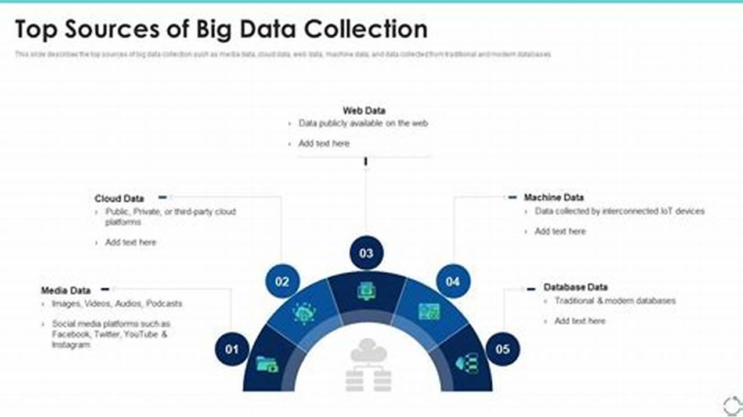
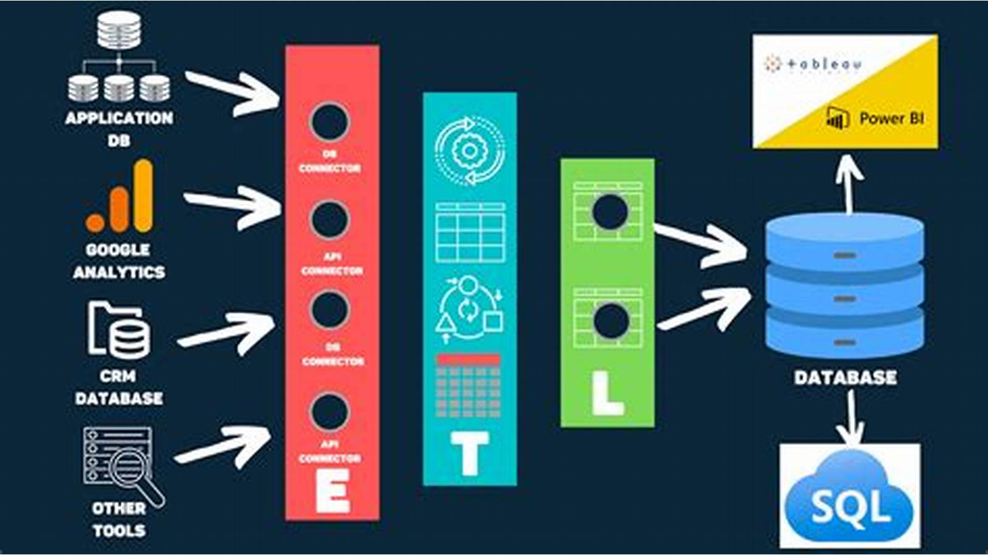

The Rise of Big Data
Expansion of Data Sources
Variety and Volume of Data
Importance of Real-Time Processing
Big data growth is driven by diverse sources like social media, IoT, e-commerce, sensors, and APIs generating vast data daily.
Organizations handle structured, semi-structured, and unstructured data measured in quintillions of bytes, creating integration challenges.
Real-time data processing reduces latency, enabling immediate analysis for applications like fraud detection and personalized experiences.

Slide 3
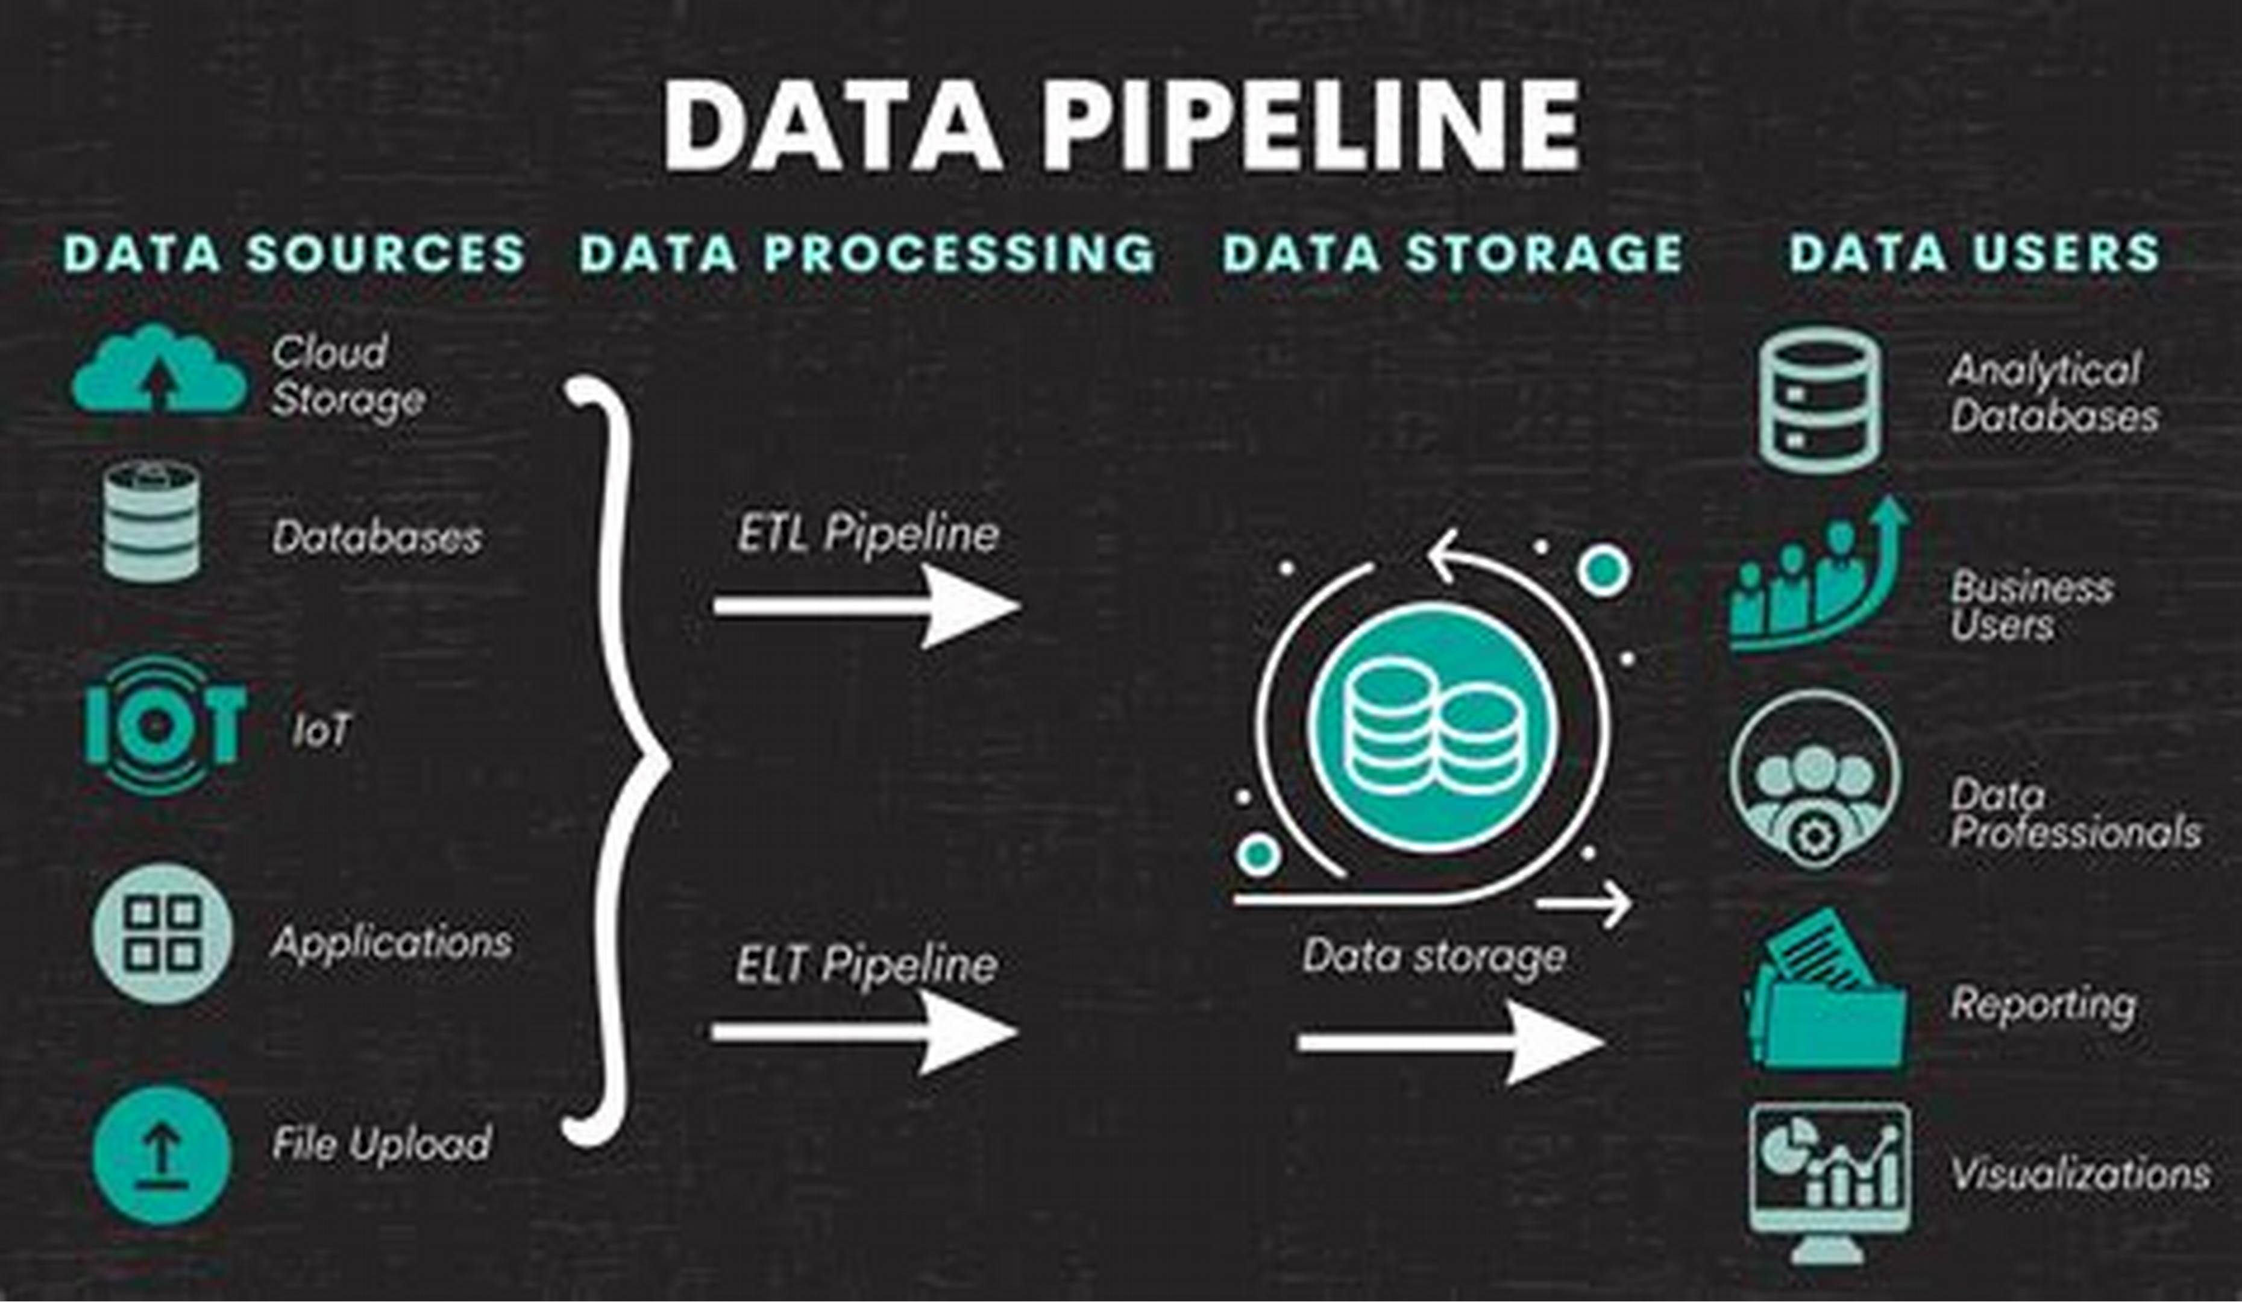
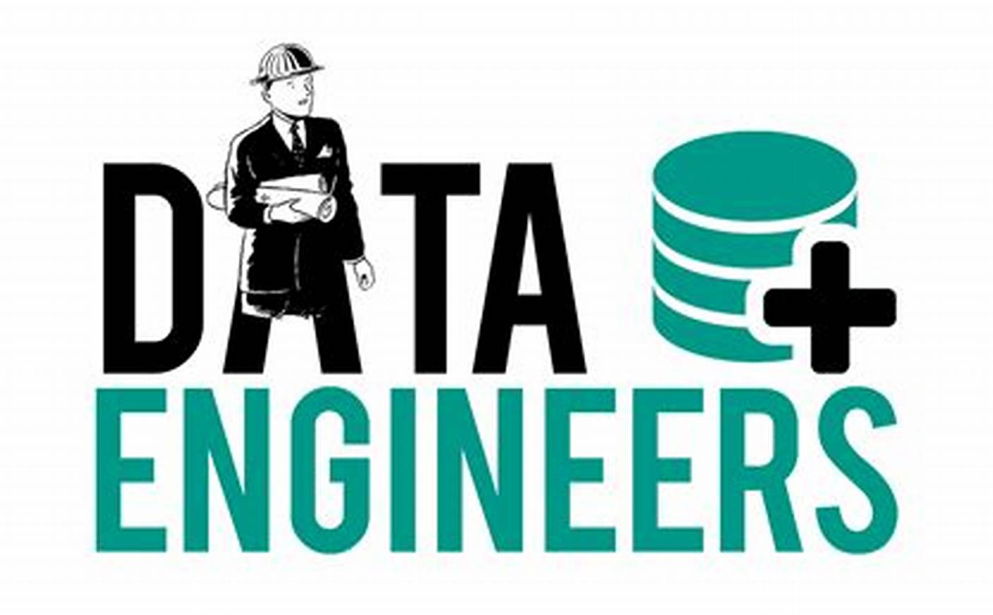
What is Data Engineering?
Definition of Data Engineering
Key Responsibilities of Data Engineers
Data engineering involves designing and maintaining data pipelines and infrastructure to ensure data is accessible and reliable for analysis.
Develop scalable data architecture, streamline data acquisition from various sources, Ingestion, storage, transformation, integration, processing, orchestration, and quality governance.

Slide 4
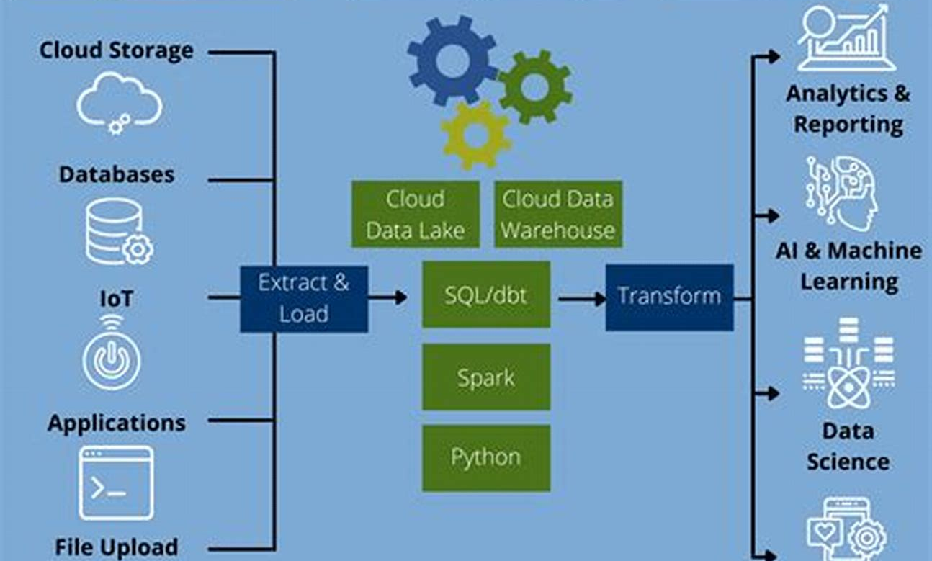
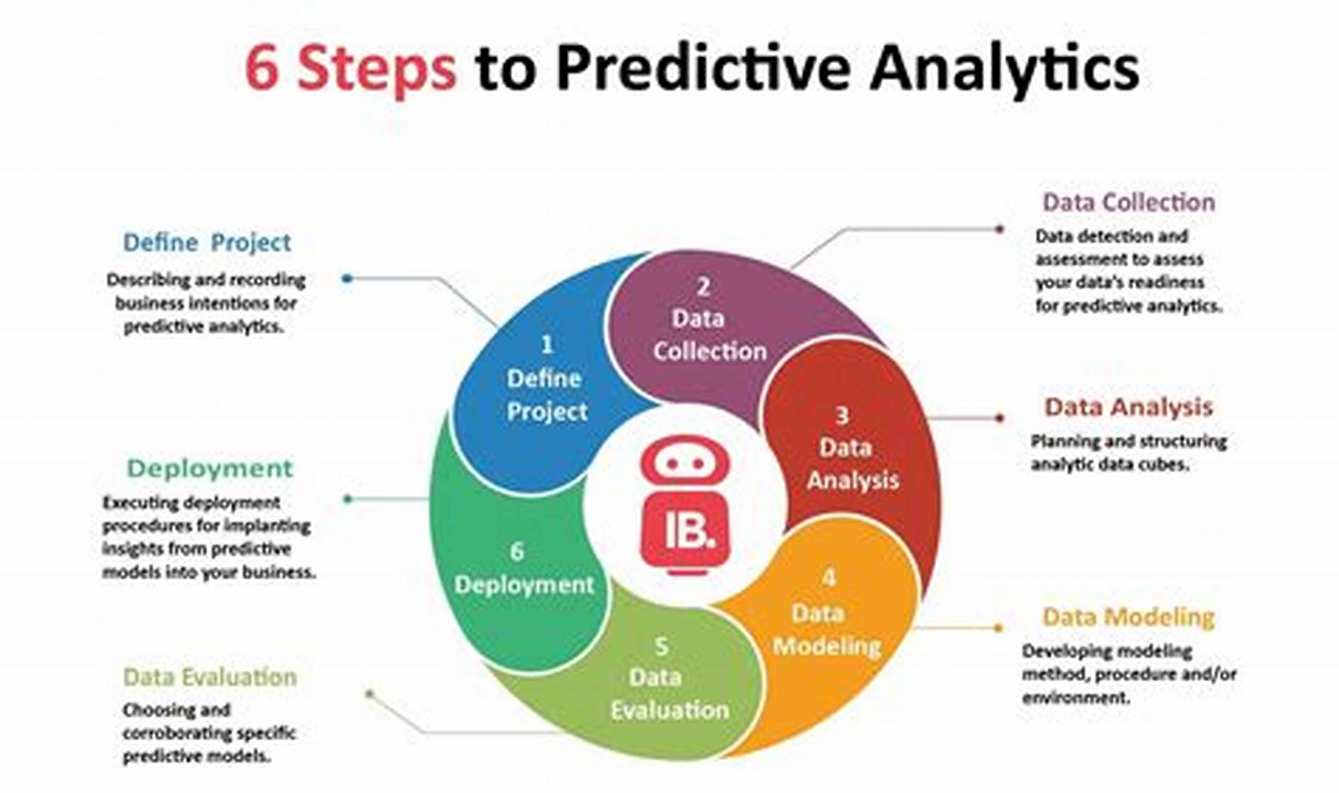

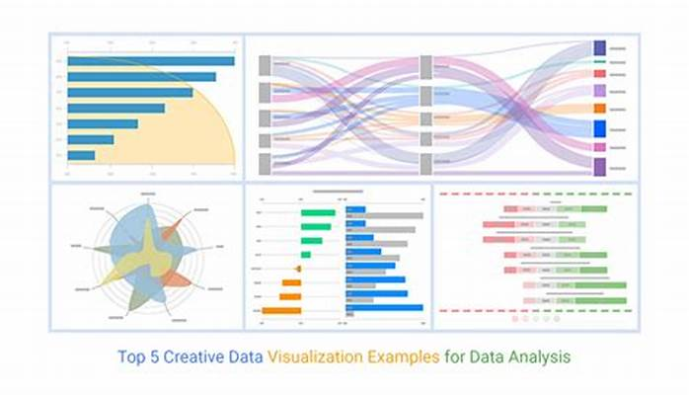
The difference between a data engineer, data scientist, machine learning engineer and data analytics
Role of Data Engineer
Role of Data Scientist
Role of Machine Learning Engineer
Role of Data Analyst
Data analysts create reports and visualizations from structured data to help stakeholders make informed decisions.
Data engineers design and maintain data pipelines and infrastructure to ensure reliable data flow for analysis and modeling.
Data scientists analyze complex data, build predictive models, and generate insights to support business decisions.
Machine learning engineers deploy and maintain scalable ML models, bridging data science and software engineering.

Slide 5
Real-World Applications
Role of Data Engineering in Industry
Examples from Leading Companies
Data engineering supports major companies by enabling efficient handling of large data volumes and real-time processing for personalized customer experiences.
Netflix, Amazon, and Uber use data engineering for real-time analytics, dynamic pricing, and optimized service delivery to enhance user engagement and profitability.

Slide 6



Importance in Modern Organizations
Decision-making Support
1
Robust data engineering ensures accessible, reliable data for rapid, informed business decisions.
Automation Benefits
2
Automated data pipelines reduce errors, save time, and enhance operational efficiency.
Scalability Advantages
3
Scalable architectures handle growing data volumes using cloud and distributed systems.

Slide 7




Data Engineering Lifecycle
Data Ingestion
1
Collect and import data from diverse sources using tools like, ADF, Airflow, Apache Kafka for real-time streaming.
Data Storage
2
Store data in scalable repositories such as data lakes, lake houses warehouses, or NoSQL databases.
Data Processing and Transformation
3
Clean, enrich, and transform raw data using ETL/ELT pipelines with tools like Python.
Data Serving
4
Make processed data accessible to users via dashboards, data marts, and OLAP systems.

Slide 8

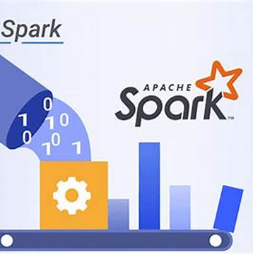
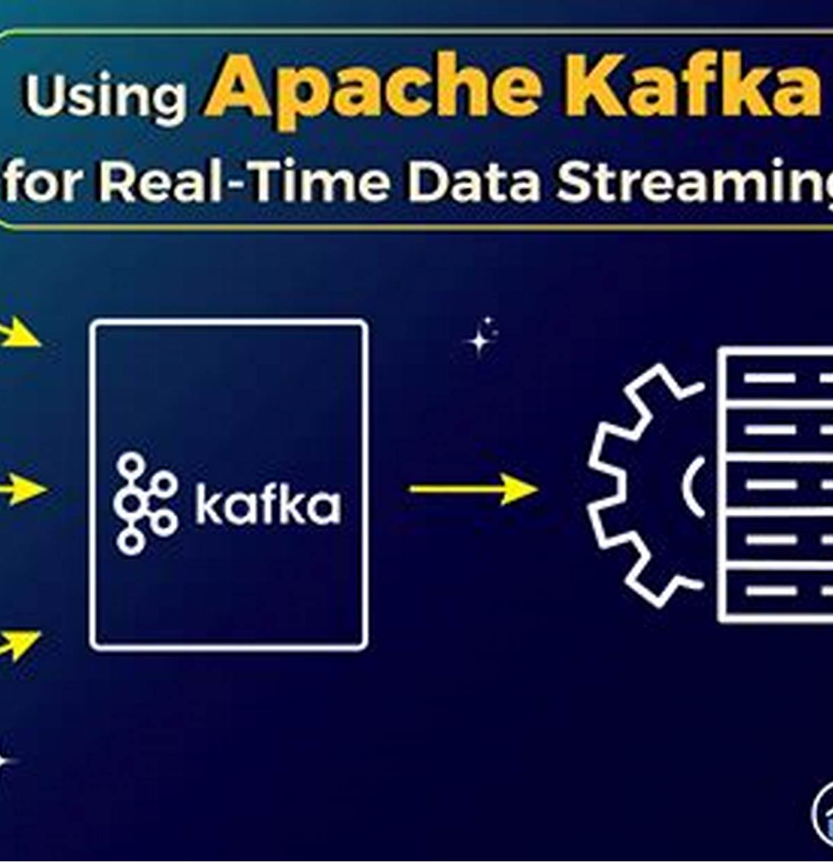
Tools of the Trade (Microsoft Fabric Data Engineer)
Core Workflow Orchestration
High-Performance Data Processing
Real-Time Data Streaming
Azure data factory is widely used for authoring, scheduling, and monitoring complex data pipelines with flexibility and scalability.
Apache Kafka enables high-throughput, fault-tolerant real-time data feeds, essential for streaming analytics and event-driven architectures.
Apache Spark supports batch, streaming, machine learning, and graph processing with in-memory computing for fast data computation.

Slide 9



Databases: SQL vs NoSQL
Structured Data Characteristics
1
Structured data is organized in predefined schemas using tables, rows, and columns, supporting complex queries with SQL databases like SQL Server and PostgreSQL.
Unstructured Data Characteristics
2
Unstructured data lacks fixed schemas and includes formats like text, images, and videos, managed by NoSQL databases such as Neo4J, MongoDB and Cassandra with flexible schemas.
Database Interface Examples
3
SQL databases display structured tables, while NoSQL dashboards show document collections or key-value pairs, illustrating their different data management approaches.

Slide 10
ETL vs ELT
Overview of ETL and ELT
Advantages and Challenges
ETL extracts, transforms, then loads data, while ELT extracts, loads, then transforms data within the target system.
ETL ensures data quality before loading but may cause latency; ELT enables faster loading and flexible transformations but requires strong target system resources.

Slide 11
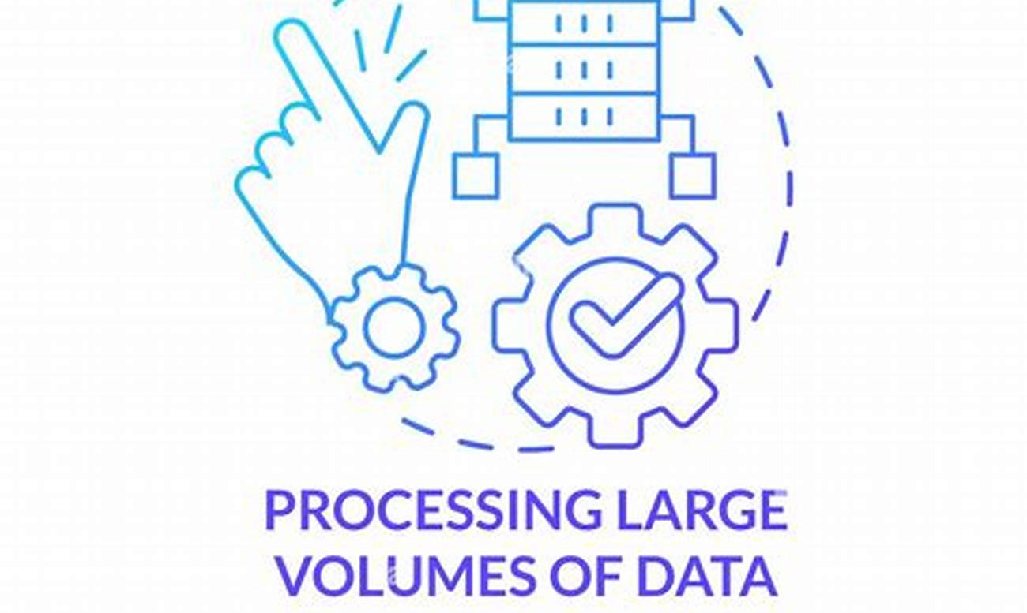
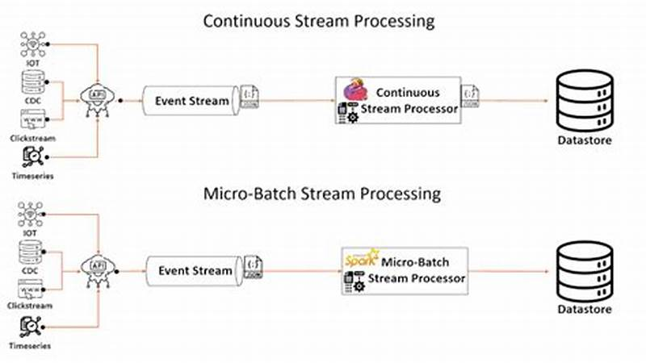
Batch vs Stream Processing
Batch Processing Overview
Stream Processing Overview
Batch processing handles large data volumes collected over time, processing them at scheduled intervals for complex computations and in-depth analytics.
Stream processing continuously ingests and analyzes data in real-time, enabling instant insights and rapid decision-making for dynamic applications.

Slide 12

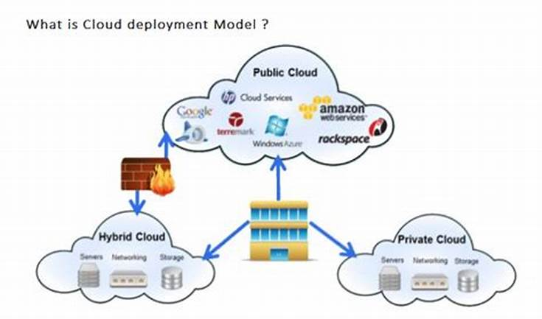
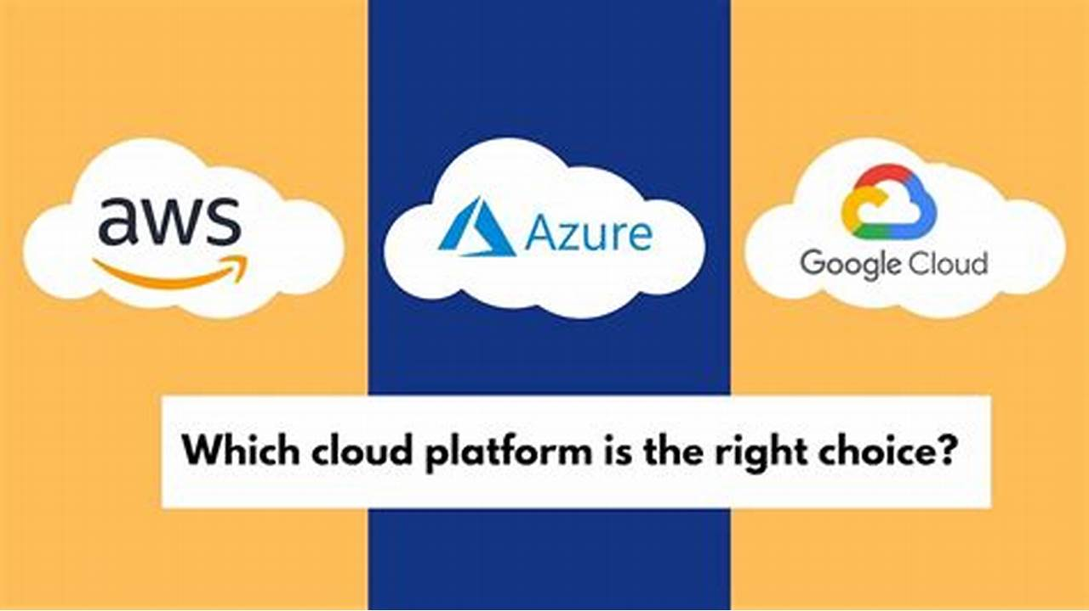

Cloud Computing?
Definition of Cloud Computing
Cloud Deployment Models
Leading Cloud Providers
Cloud Data Engineering
Cloud computing delivers computing services over the internet, enabling faster innovation and flexible resource use without owning infrastructure.
Public, private, and hybrid clouds offer different levels of resource sharing and control to meet diverse business needs.
AWS, Microsoft Azure, and Google Cloud Platform dominate with unique strengths in services, integration, and analytics.
Cloud platforms provide scalable tools for building data pipelines, warehousing, ETL, and real-time analytics.

Slide 13
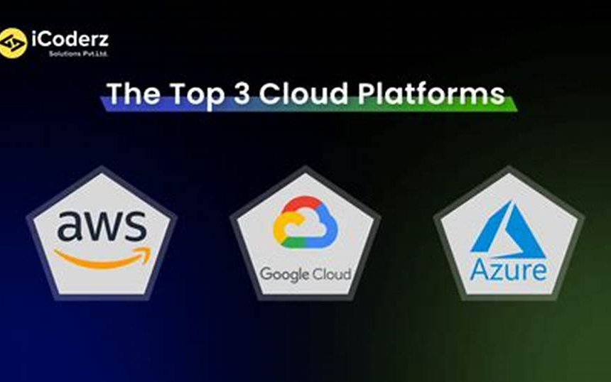
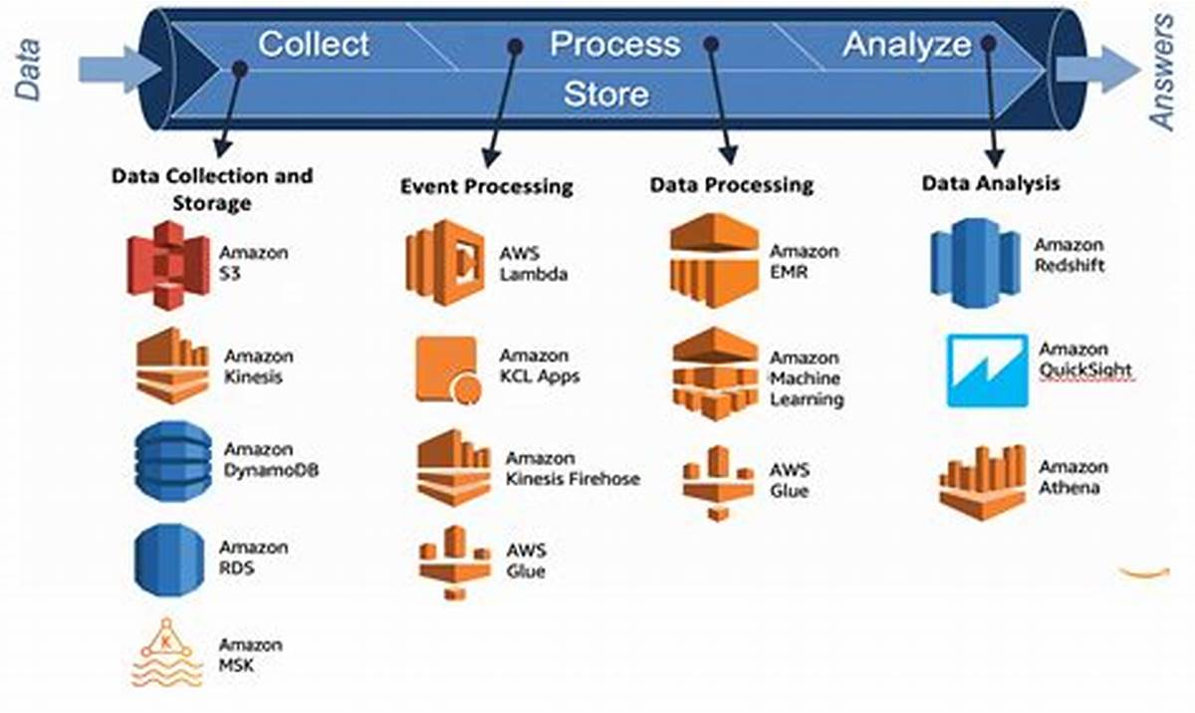
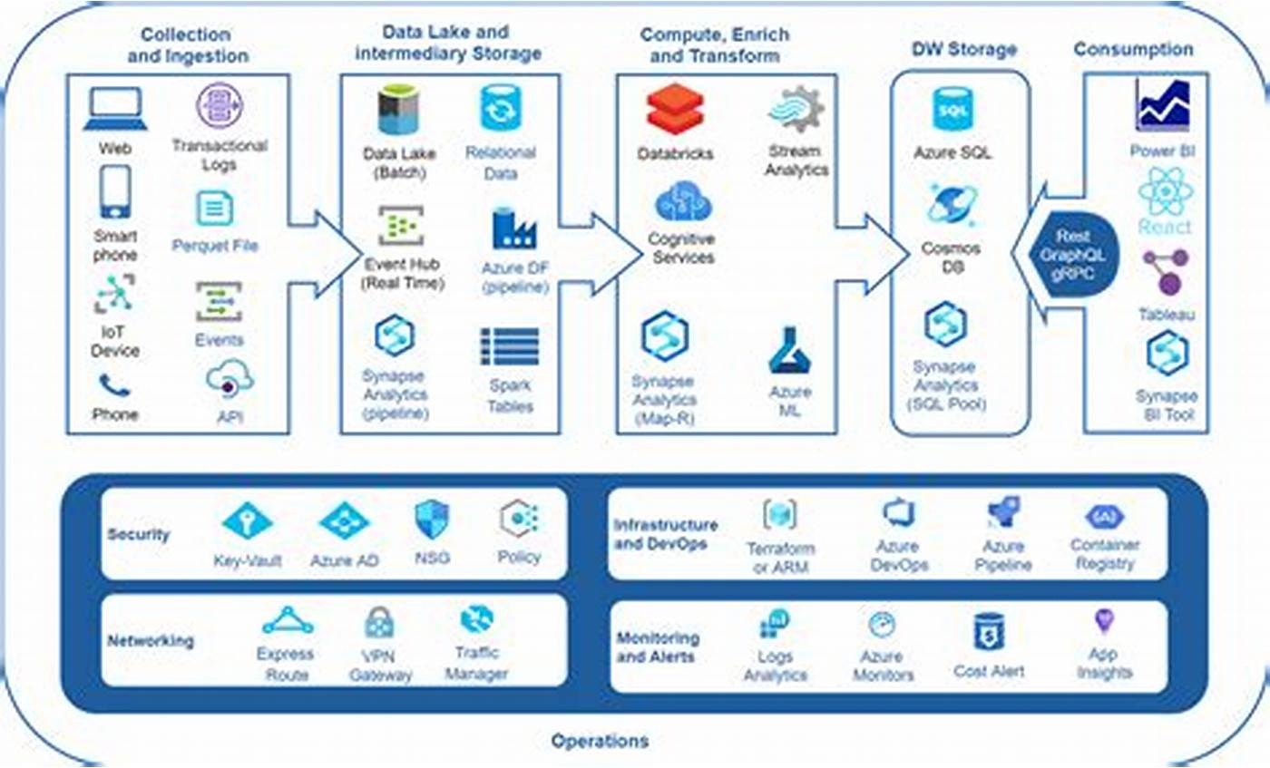
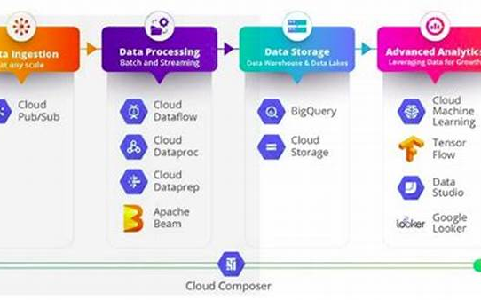
Major Cloud Data Engineering Providers
Leading Cloud Providers in Data Engineering
Amazon Web Services (AWS) Overview
Microsoft Azure Capabilities
Google Cloud Platform (GCP) Strengths
Azure focuses on enterprise and hybrid solutions, integrating well with Microsoft products and offering Microsoft fabric, and Power BI
The top three cloud providers are AWS, Microsoft Azure, and Google Cloud Platform, each offering specialized data services.
AWS provides an ecosystem with services like EMR, Kinesis, Redshift, and Glue, excelling in scalability and real-time analytics.
GCP is known for web analytics and machine learning tools such as Dataproc, Dataflow, BigQuery, and Cloud Composer, with a user-friendly interface.

Slide 14
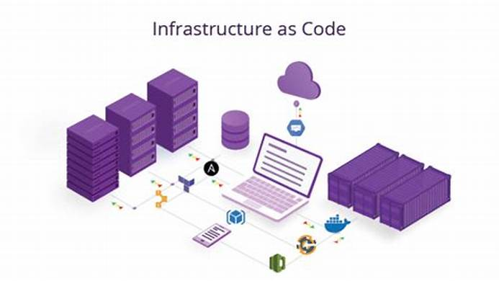
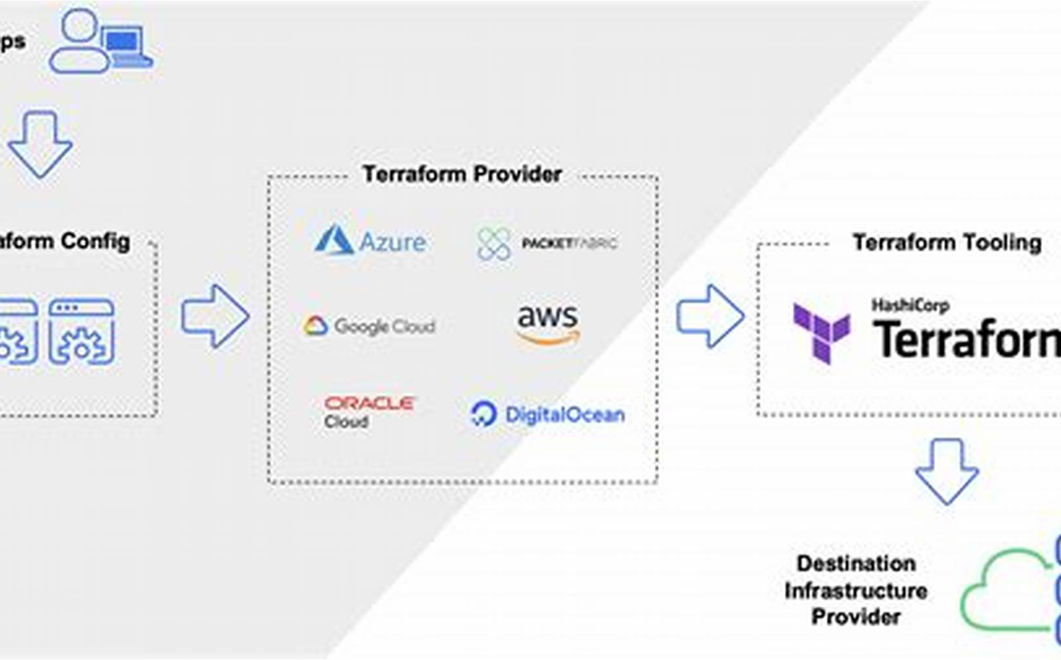
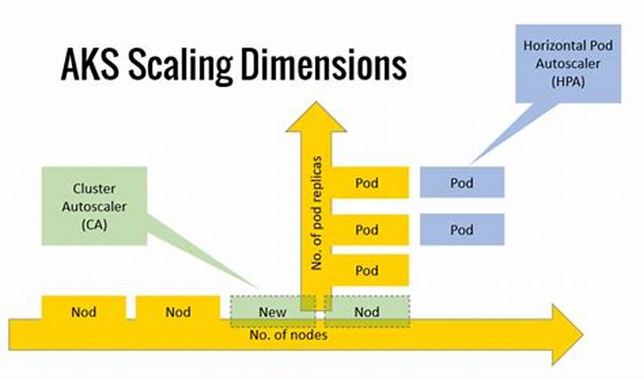
Infrastructure as Code & Scalability in Microsoft fabric data engineering
Role of Infrastructure as Code in Data Engineering
Tools and Techniques for IaC in Microsoft Fabric
Scalability through Automation and Autoscaling
Infrastructure as Code (IaC) automates cloud infrastructure management, enhancing deployment efficiency and consistency in data engineering.
Tools like Terraform and Azure Resource Manager enable automated deployment and management of data pipelines and resources in Microsoft Fabric.
Combining IaC with autoscaling features, such as Spark cluster scaling, ensures flexible resource adjustment to meet dynamic data workloads.

Slide 15
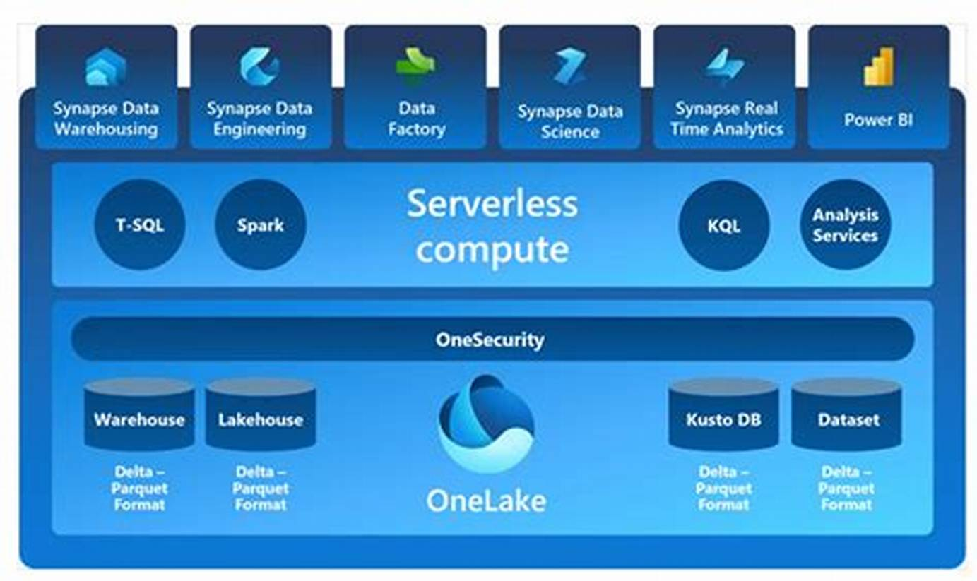


Security & Compliance Microsoft Fabric data engineering
Security Framework in Microsoft Fabric
Compliance Standards Adherence
Data Protection Mechanisms
Advanced encryption, access controls, and monitoring tools safeguard data throughout its lifecycle.
Microsoft Fabric integrates robust security measures to protect data engineering workflows and assets.
The platform complies with industry standards and regulations to ensure data governance and privacy.

Slide 16
Future Of Jobs Report 2025
2025 Job Market Trends
Key Skills Required
Career Pathways
Data engineer demand grows with cloud, big data, and AI importance.
Programming in Python, SQL, Scala, Java; cloud skills in Azure, AWS.
Roles include Data Engineer, Analytics Engineer, Platform Engineer.
1
2
3
4
5
6
Industry Demand
Additional Skills
Future Outlook
High demand in finance, healthcare, retail, and tech startups.
ETL/ELT pipelines, SQL/NoSQL, real-time streaming, infrastructure as code.
Strong growth driven by cloud computing and real-time analytics focus.

Slide 17
Skills in Demand
Core Programming Skills
1
Python programming is essential for scripting, automation, and integrating data processing frameworks.
2
Database Management
Advanced SQL proficiency enables efficient querying and management of structured data and data warehouses.
Workflow Orchestration
3
Expertise in Azure Data Factory supports automation and reliable scheduling of complex data pipelines.
4
Communication and Problem Solving
Strong communication and analytical problem-solving skills ensure alignment with business goals and effective issue resolution.

Slide 18
Career Pathways
Emergence of Data Engineering
Entry-Level Responsibilities
Senior and Leadership Roles
Data engineering grows rapidly due to increasing data volumes and reliance on data-driven decisions.
Focus on building data pipelines, ETL/ELT processes, and designing data architectures.
Opportunities to become Data Architect, Lead Data Engineer, or Chief Data Officer.
1
2
3
4
5
6
Core Roles in Data Engineering
Mid-Level Progression
Skills and Qualifications
Advance to senior roles leading scalable platform design and complex data workflows.
Master programming, big data tools, cloud platforms, governance, and obtain certifications.
Includes Data Engineer, Analytics Engineer, Platform Engineer, and AI/Machine Learning Engineer.

Slide 19
Final Thoughts & Resources
The Role of Data Engineering
Continuous Learning and Resources
Data engineering builds robust data architectures and pipelines, enabling reliable and high-quality data for analysis and decision-making.
Staying current with cloud, real-time processing, and AI requires ongoing learning through MOOCs, product documentation, blogs, and professional certifications.
Links:
Future of Jobs report 2025
Uk Salary Trends Report
Future Trends for Success
Microsoft Learn

Slide 20
Q&A and Contact Information
Q&A Sessions
1
2
Contact Information
What's app: 07778419886

Slide 21
Thank You

